Slide 1



MARKETING CAMPAIGN ANALYSIS
Capstone Project Report
Notes:
Good morning, good afternoon, good evening depending on where you’re located. My name is Ted Summey and I’ll be presenting a summary of a marketing campaign analysis project. The presentation is high-level, but there is an 18-page report that provides more detail

Slide 2




Executive Summary
Key Highlights
Problem Statement
Marketing-to-sales conversion rates are impacting revenue and growth.
Proposed Model
Data exploration, analysis, and analytics to identify insight and groups
Project Context
Marketing Analytics produces better, data-driven decisions optimizing ROI.
Measures of Success
Compare previous metrics to metrics from new date-driven campaigns
Project Objective
Analyzing marketing data to Identify customer traits and similar groups.
Key Takeaway
Understanding customer similarities and traits increases sales and growth
Notes:
The analytics portion of the project is complete. The problem statement originates from a hypothesis that marketing-to-sales conversation rates are low due to a lack of data analytics and data-driven decision making around Marketing activities. The objective of the project was to use Data Science methods to reveal insights into customer traits and identify groups of customers with similar characteristics and behaviors. The proposed model is using Data Exploration, Analysis, and Analytics to identify patterns, insights, correlations, and clusters around customers, products, and sales channels. The takeaway from the Data Science results is that understanding customer traits and similarities leads to increased revenue and growth.

Slide 3
What’s the problem?
Marketing-to-sales conversion rates are impacting revenue and growth.
Missing customer characteristics and behaviors
No insight into customer similarities
Poor marketing-to-sale performance
Low offer acceptance – Wrong product or messaging
Unoptimized ROI – Loss of revenue and growth
Notes:
The problem snowballs starting with a lack of understanding existing marketing data. Missing customer characteristics and behaviors leads to a lack of customer insights meaning the wrong products or messaging is presented to customers leading to low offer acceptance resulting in poor marketing-to-sales conversions. This has a direct impact on revenue and growth.

Slide 4
Proposed Approach:
Data Science
Data-Driven Marketing Campaigns
What’s in the dataset?
Data Exploration
and Analysis
What’s wrong in the dataset?
Data Processing
Customer and Campaign Insights
Univariate and Bivariate
Analysis
Deeper Insights and Customer Grouping
Correlation and Clustering
Notes:
The proposed solution was using Data Science methods to extract information that could improve marketing activities. Data Exploration and Analysis methods help understand the content in the dataset. Following Data Exploration is Data Processing. Simply put this is where any missing values are identified and addressed, columns are identified that may have no value, and extra columns can be created that can provide better insights. Once the is complete the data is ready for analytics. To begin, two types of data analysis was performed, univariate and bivariate. Think of univariate as the analysis of one set of values, and bivariate is the analysis of the relationship between two sets of values. Following univariate and bivariate analysis the next method used is a Heatmap, sounds complicated but it really only means a graphical representation of data was created where values are depicted by colors. It visualized relationships in the dataset using gradients of colors to indicate hot and cold. Hot simply means a good correlation and cold a weak correlation. The next techniques applied are dimensionality reduction techniques called Principal Component Analysis and T-distributed Stochastic Neighbor Embedding (T-SNE). Think of these methods as linear and non-linear methods for summarizing the dataset without losing any information. By applying these techniques, data may being to cluster providing insight into customer similarities. Finally, two additional tech are for clustering data called K-Means and K-Mediods which was used to generate customer profiles. All to create insights to create data-driven marketing campaigns.

Slide 5
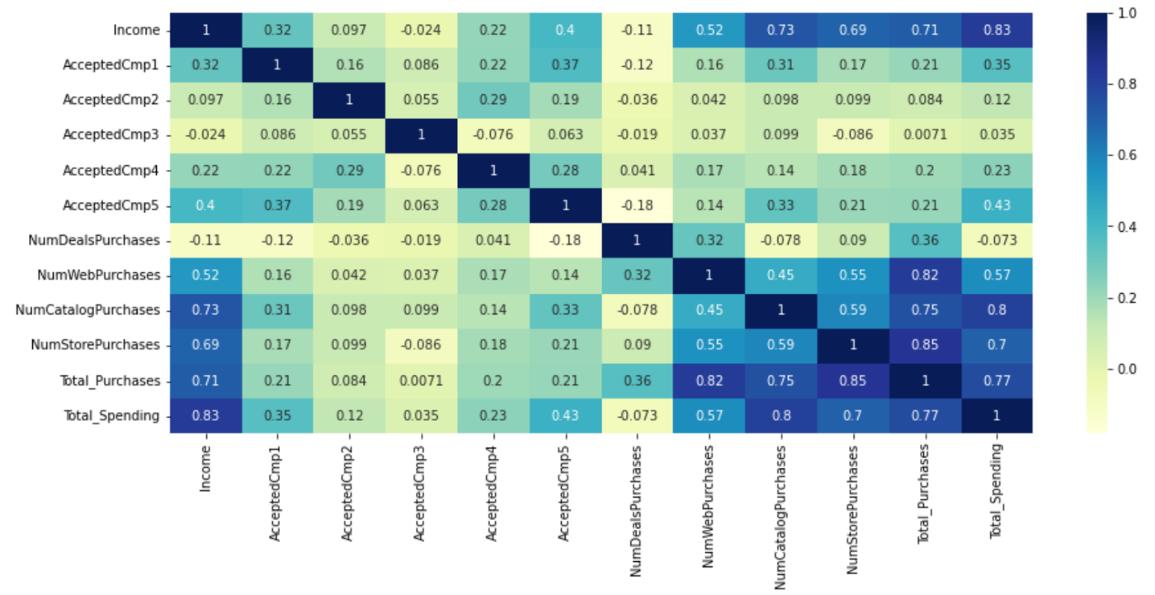
Proposed Approach:
Data Science: Heatmap Evidence
Notes:
Here is a a heatmap from the report

Slide 6
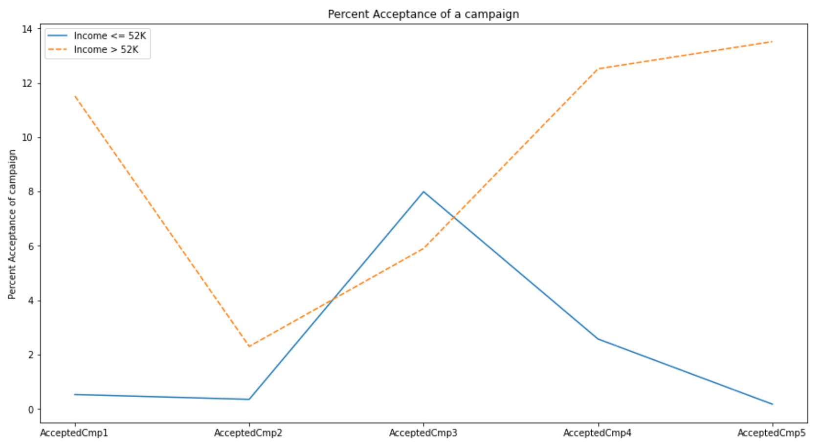
Proposed Approach:
Data Science: Line Plot Evidence
Notes:
This is a plot from the report showing campaign acceptance by income.

Slide 7
Data Science: Customer Insights
Customer Characteristics
Average income is $52,000
Average age is between 40 and 50 years old
Customer Behaviors
Prefer shopping in stores
Campaign Performance
Campaign 3 was the most successful reaching customer of all incomes.
Majority of customers are married
Majority of customer do not have children
Most spend less than $250
Purchase between 5 and 9 products a month
Visit the website 7 times per month
Campaign 5 was successful with customers earning more than 52k.
Campaign 3 was most successful with customer earning less than 52k
Product Performance
Channel Performance
Wine was purchased the most
Customers spent more on meat
Fruit is purchased least often
Most items are purchased from stores.
That average number of days between purchase
Customer wait an average of 49 days between purchases
Most customer have graduated
50 percent of website visits result in a purchase
More spending occurs from catalog purchases
Fish is most often ordered from a catalog
Deals seem to correlate with web purchases
Notes:
Derived from univariate, bivariate, heatmap analysis customer insights and campaign insights began to emerge.

Slide 8
Data Science: Campaign Insights
Campaign 1
Targets Catalog channel
Campaign 2
Campaign 5
Targets Catalog sales
Poorest performing campaign @ 1.2% acceptance rate
The data indicates these are returning customers
Campaign 3
Campaign 4
Wine, Meat, Fish, and Sweets are popular products
121 customers responded, a 5.4% acceptance rate
Customer that responded earn greater than 52k per year
The data indicates these are returning customers
No clear customer or product targets
27 customers responded to this campaign
Targets the Website channel
Gold is inferred to be the targeted product
149 Customers responded to this campaign
The data indicates these are returning customers
Reaches customers above and below an average earnings of 52k per year.
Has the 2nd highest acceptance rate @ 6.7%
Inferred to the most accepted campaign @ 6.9%
Targets the Catalog, Store, and Website channels
Wine is the popular product
Most popular with customers earning over 52k per year
Near equal acceptance across all customers.
Popular products are Wine and Meat
136 customers responded to the campaign, a 6.1% acceptance rate
The data indicates these are returning customers
The majority of customers earned more than 52k per year
The data indicates these are returning customers
Notes:
Here is the sample of insights for campaigns

Slide 9
Data Science:
Profile Insights
Customer Profile 1
Has the highest average income
Customer Profile 2
Has the lowest average income
Customer Profile 3
Meat and Wine are the most popular products
Purchased Wine more than the other profiles
Prefer purchasing in stores, but use the catalog and website as well
The data indicates these are returning customers
Incomes are close to the average income of all customers.
Responded well to Campaigns 1, 4, and 5
Meat and Wine are the most popular products
They prefer to purchase online, but do purchase in stores as well
Wine, Meat, and Gold are the most popular products
The prefer shopping in stores and online equally, but do also use catalogs
The data suggests that this profile takes advantage of deals more than the other groups
Notes:
Explaining how PCA, t-SNE, K-Means, and K-Mediods is difficult and we could have an additional deep-dive meeting walk through it. However, these techniques yielded three distinct customer profiles.

Slide 10
Next Steps
and recommendations
1
Review the report findings
Define performance goals based on previous data set.
2
Create new campaigns
The right customer needs to see the right product, with the right messaging.
3
Begin campaigning and track metrics
Expand the target audience and collect the data
4
Measure the success
How do the numbers compare to the previous campaign

Slide 11
Benefits and Competitive Advantage
Benefits
Lower risk in decision making
Business becomes more agile
Increase business intelligence
Improves business predictions
Notes:
This presentation has split into two purposes. First is addressing the marketing performance, given this data I recommend the entire process up to K-Means and K-Mediods. The dataset has many extreme outliers, the performance of K-Means can be impacted by outliers because clustering uses the mean values of groups. Compared to K-Mediods uses actual values in the dataset to define the cluster centers. The second purpose is incorporating Data Science in the organization. There are many benefits to data science that could extend business analytics, operations analytics, and more.

Slide 12
Thank you for your time

Slide 13
Questions?

